Slide 1
Analysis of single-cell RNA-seq data (IV)
Hao Wu
Department of Biostatistics and Bioinformatics
Rollins School of Public Health
Emory University
Ziyi Li
Department of Biostatistics
The University of Texas MD Anderson Cancer Center
ENAR 2021 short course
March 2021

Slide 2
Course outline
8-9:15: Intro and data preprocessing.
9:15-9:45: Lab: preprocessing and visualization.
10-11:15: Normalization, batch effect, imputation, DE, simulator.
11:15-12: Lab: Normalization, batch effect, imputation, DE, simulator
12-1: Lunch break
1-2: Clustering and pseudotime construction
2-2:30: Lab: Clustering and pseudotime construction
2:45–3:30: Supervised cell typing & related single cell data sources
3:30-4: Lab: supervised cell typing.
4:15-5: scRNA-seq in cancer

Slide 3
Outline for this session
Background
Motivation
Assumptions and challenges
Cell type annotation
Existing methods
Performance comparisons and considerations
Obtain existing single cell datasets
Data integration
Future directions

Slide 4
Example scRNA-seq analysis workflow
Kiselev et al. (2019) Nat. Rev. Genet.

Slide 5
Motivation
Another paradigm to identify cell type.
Cell clustering (unsupervised):
Cluster cells to multiple clusters (unsupervised). then assign cell type for each cluster. - laborious, lack of reproducibility
Cell type assignment (supervised):
Directly assign each cell to a cell type.
Requires some training data (supervised) or marker gene info.
Potentially work better for data from multiple samples.
Can incorporate the hierarchy in cell types.
Cannot identify new cell types (restricted to the known cell types in the reference).

Slide 6
Cell type annotation
Require the input of marker gene information
DigitalCellSorter (BMC bioinfo, 2019)
Garnett (Nature methods, 2019)
CellAssign (Nature methods, 2019)
SCINA (Genes, 2019)
scSorter (Genome Biology, 2021)
Pre-train a classifier using scRNA-seq training data with generic machine learning methods: SVM, LDA, RF, kNN, RF
Scmap (Nature methods, 2018)
CHETAH (NAR, 2019)
CaSTLe (PloS One, 2018)
scPred (Genome Biology, 2019)

Slide 7
Cell type annotation (continue)
Use either sc or bulk RNA-seq as reference
singleR (Nat Immunol, 2019)
A comparison paper: Abdelaal et al. (2019, GB)
Annotation performance is a trade-off between accuracy and un-assigned rate

Slide 8
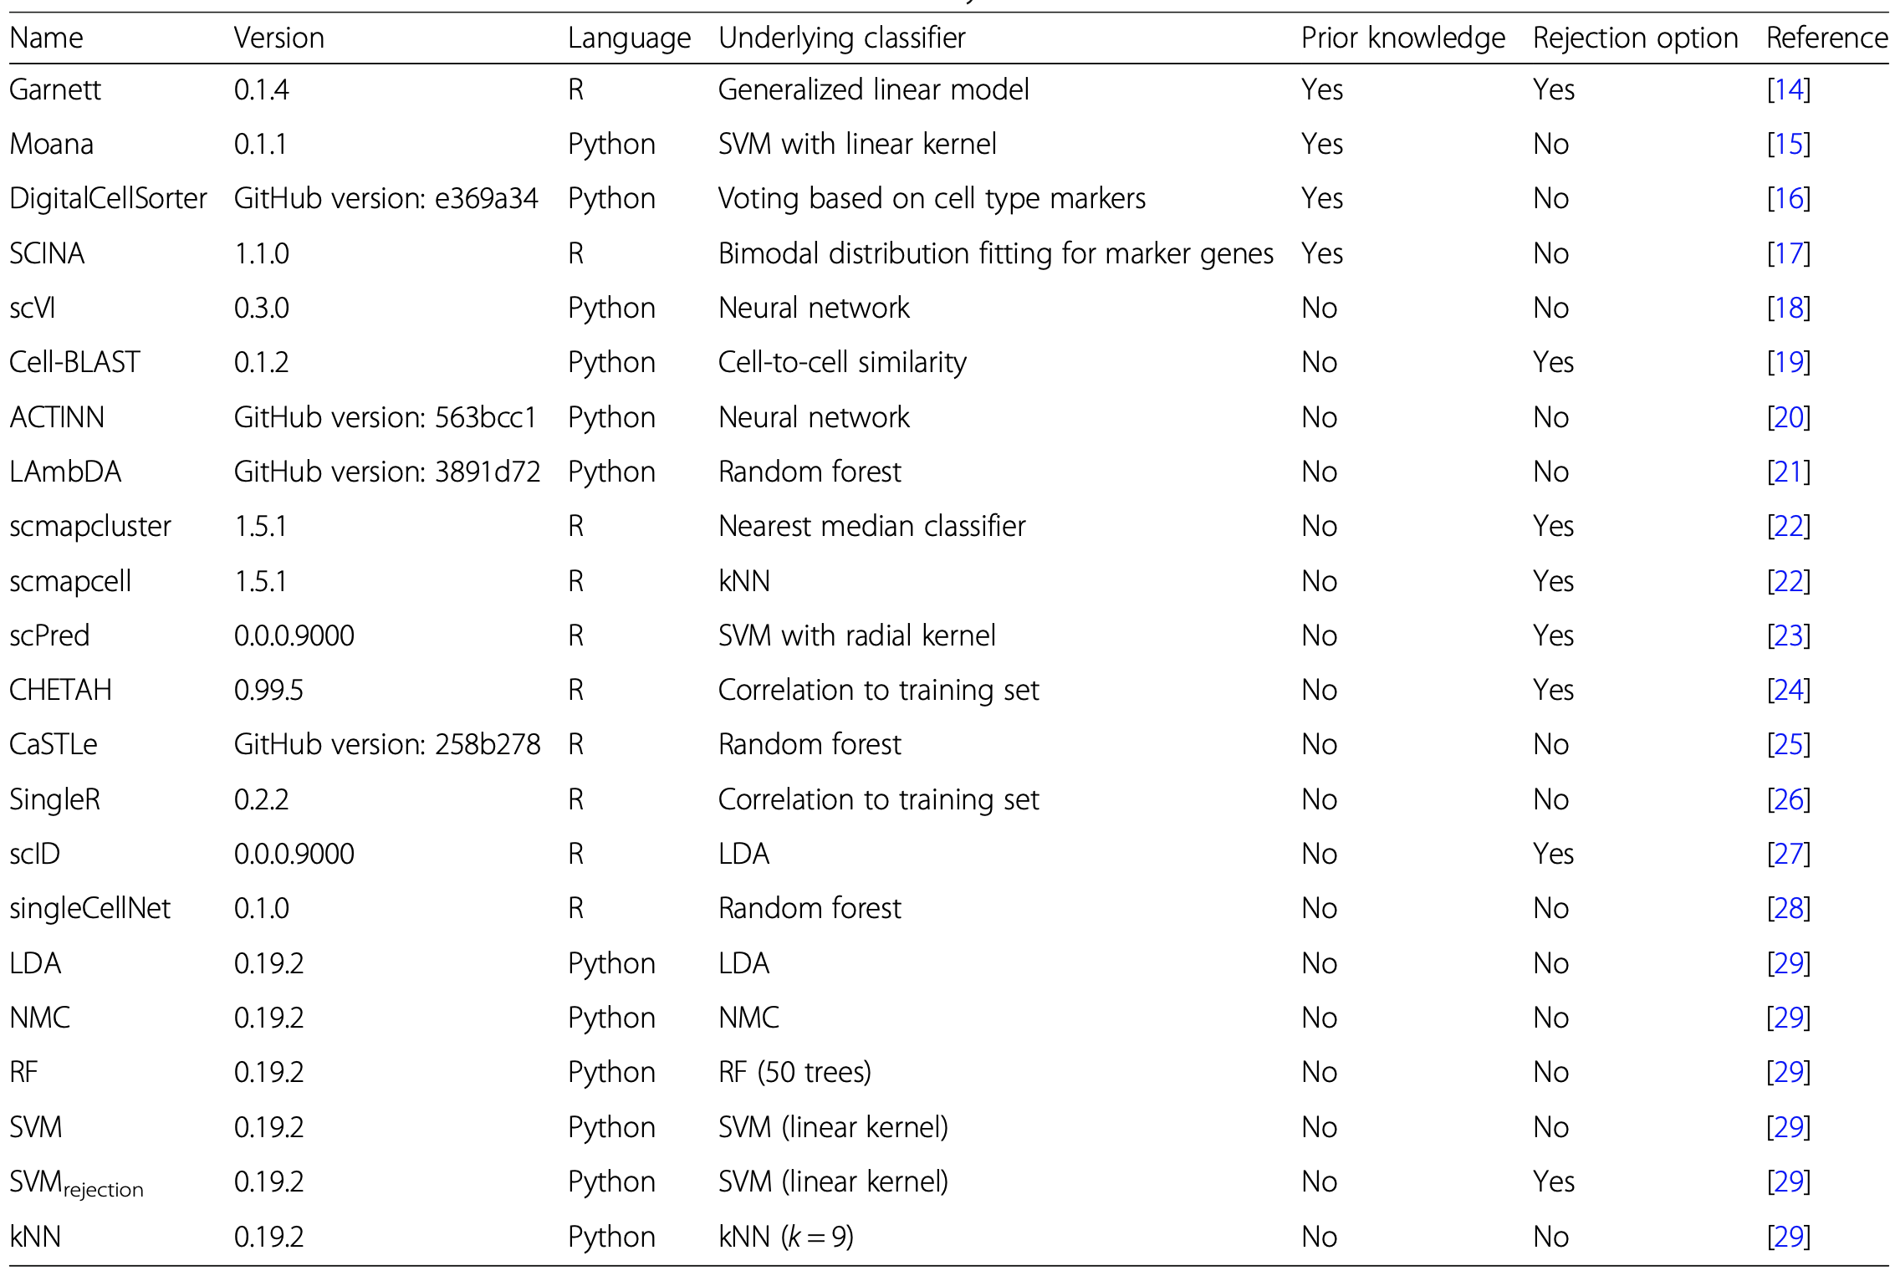
Abdelaal et al. (2019, GB)

Slide 9
Cell type annotation
Require the input of marker gene information
Garnett (Nature methods, 2019)
scSorter (Genome Biology, 2021)
Pre-train a classifier using scRNA-seq training data with generic machine learning methods: SVM, LDA, RF, kNN, RF
Scmap (Nature methods, 2018)
CHETAH (NAR, 2019)
Use either sc or bulk RNA-seq as reference
singleR (Nat Immunol, 2019)

Slide 10
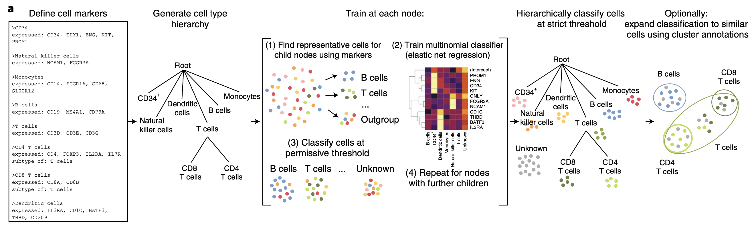
Garnett

Slide 11
Garnett

Slide 12
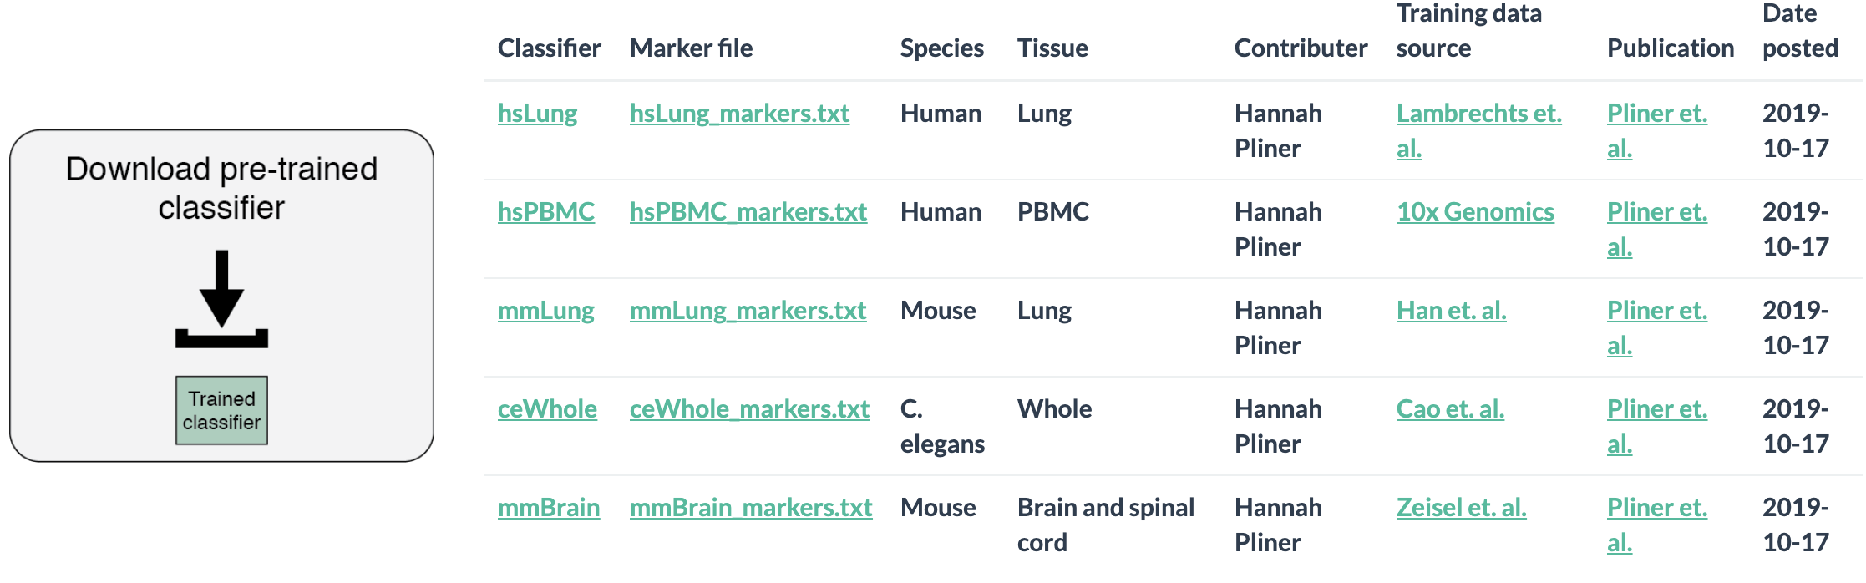
Available pre-trained classifier for Garnett

Slide 13
Example code for Garnett
marker_file_path <- system.file("extdata", "pbmc_test.txt", package = "garnett")
pbmc_classifier <- train_cell_classifier(cds = pbmc_cds,
marker_file = marker_file_path,
db=org.Hs.eg.db,
cds_gene_id_type = "SYMBOL",
num_unknown = 50,
marker_file_gene_id_type = "SYMBOL")
pbmc_cds <- newCellDataSet(as(mat, "dgCMatrix"),
phenoData = pd,
featureData = fd) # generate size factors for normalization pbmc_cds <- estimateSizeFactors(pbmc_cds)
pbmc_cds <- classify_cells(pbmc_cds,
pbmc_classifier,
db = org.Hs.eg.db,
cluster_extend = TRUE,
cds_gene_id_type = "SYMBOL")
https://cole-trapnell-lab.github.io/garnett/docs/#2-classifying-your-cells

Slide 14
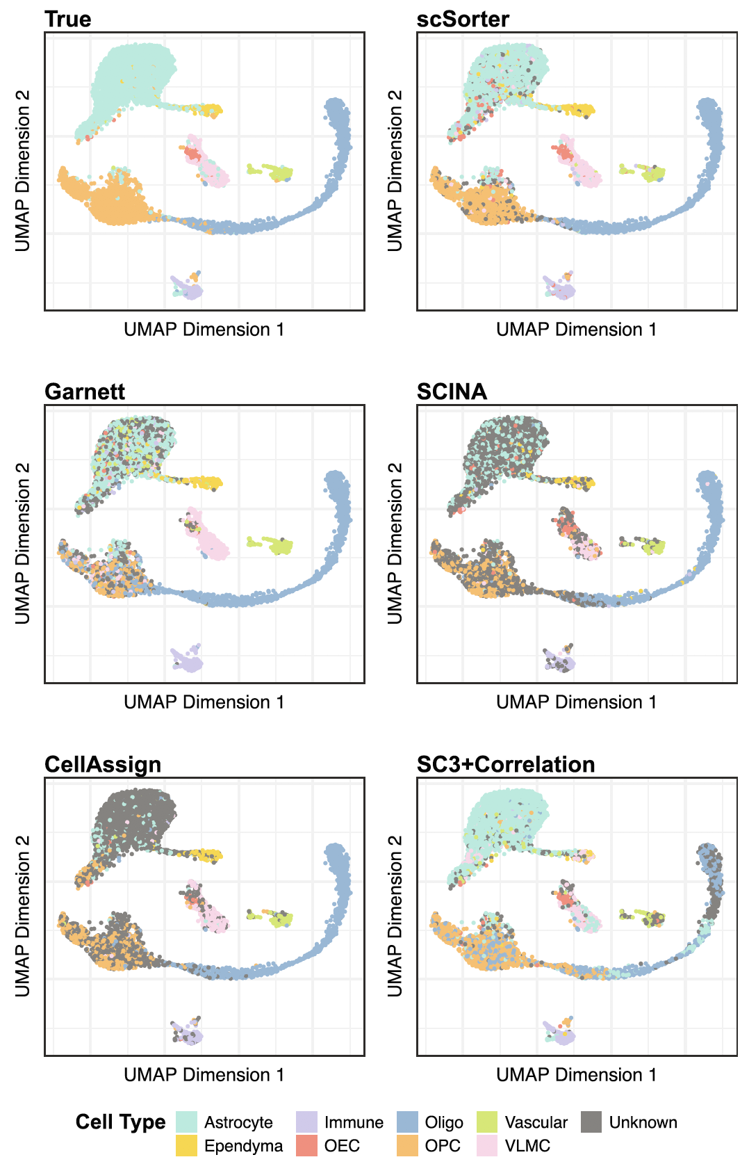
scSorter
Given marker genes, their exact expression levels are not assumed known, and no reference dataset is used.
Borrow information from non-marker genes

Slide 15
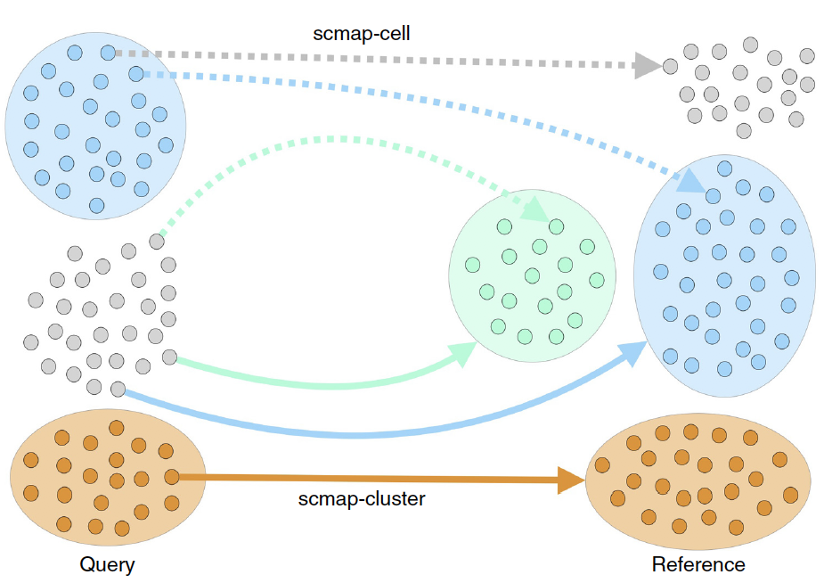
scmap
Correlation-based cell
label assignment
Fast and accurate
A correlation threshold to control the percentage of assigned cells, cells below the threshold are “unassigned”

Slide 16
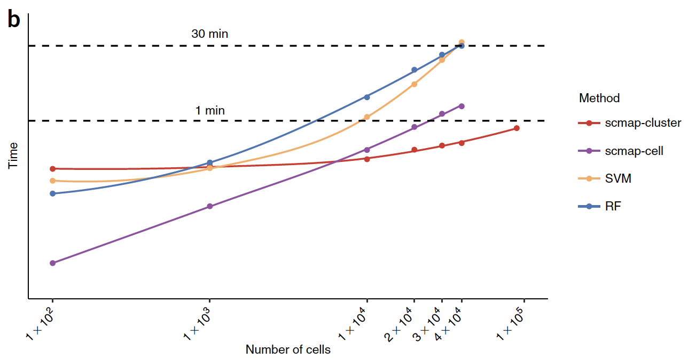
scmap

Slide 17
Example code for scmap
sce <- SingleCellExperiment(assays =
list(normcounts = as.matrix(trainmat)),
colData = DataFrame(cell_type1 = trainlabel))
logcounts(sce) <- log2(normcounts(sce) + 1)
rowData(sce)$feature_symbol <- rownames(sce)
sce <- selectFeatures(sce, suppress_plot = TRUE)
sce_test <- SingleCellExperiment(assays =
list(normcounts = as.matrix(testmat)),
colData = DataFrame(cell_type1 = testlabel))
logcounts(sce_test) <- log2(normcounts(sce_test) + 1)
rowData(sce_test)$feature_symbol <- rownames(sce_test)
sce <- indexCluster(sce)
scmapCluster_results <- scmapCluster(projection = sce_test,
index_list = list(metadata(sce)$scmap_cluster_index))

Slide 18
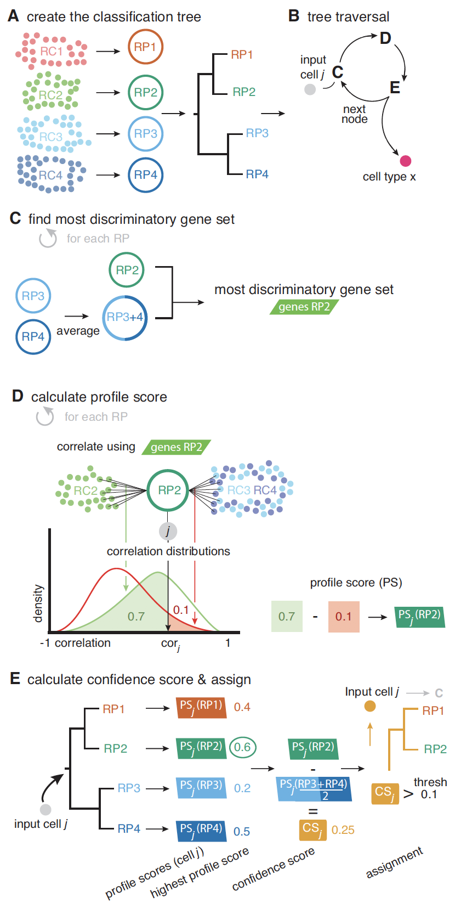
CHETAH
First, a hierarchical classification tree is constructed from the reference scRNA-seq data
Selecting the set of genes that best discriminates each reference cell type from all the cell types, collectively, in the opposite branch of the tree

Slide 19
CHETAH
Calculate profiles score calculated from the position of input cell’s correlation within these two reference cell distributions
The confidence score is calculated as the difference of the highest profile score in chosen the branch and the average of profile scores in the other branch
Cells do not meet confidence threshold will be labeled as unassigned if the evidence runs out at the top of the tree, or as intermediate if this happens within the classification tree

Slide 20
Example code for CHETAH
sce_train <- SingleCellExperiment(assays =
list(counts = as.matrix(trainmat)),
colData = DataFrame(celltypes=trainlabel))
sce_test <- SingleCellExperiment(assays =
list(counts = as.matrix(testmat)),
colData = DataFrame(celltypes = testlabel))
#run classifier
test <- CHETAHclassifier(input = sce_test,
ref_cells = sce_train)
test$celltype_CHETAH

Slide 21
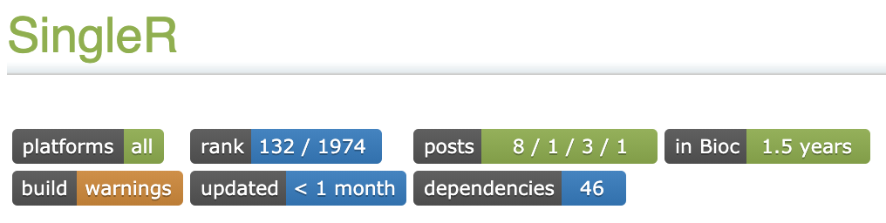
Correlation based annotation
Allow the use of bulk or scRNA-seq data as the reference
Has a built-in reference from Human Primary Cell Atlas

Slide 22
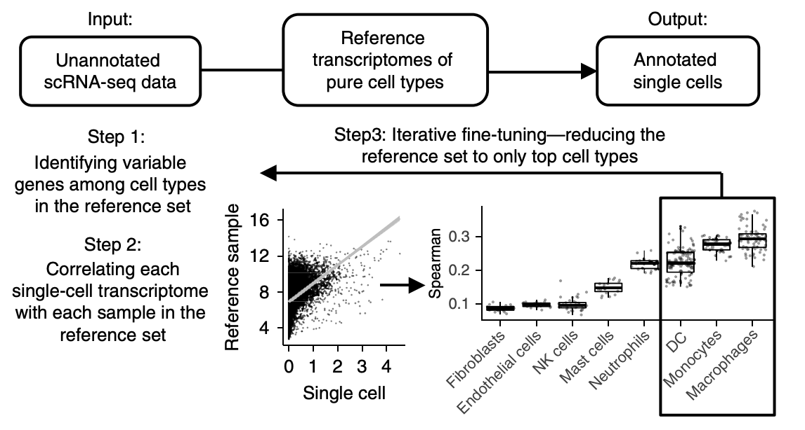

Slide 23
Example code for SingleR
# use pre-built reference data
library(celldex)
hpca.se <- HumanPrimaryCellAtlasData()
library(SingleR)
pred.hesc <- SingleR(test = hESCs, ref = hpca.se, assay.type.test=1, labels = hpca.se$label.main)
# build reference data by ourselves
# SingleR() expects reference datasets to be normalized and log-transformed.
library(scuttle)
sceM <- logNormCounts(sceM)
sceG <- sceG[,colSums(counts(sceG)) > 0] # Remove libraries with no counts. sceG <- logNormCounts(sceG)
pred.grun <- SingleR(test=sceG, ref=sceM, labels=sceM$label, de.method="wilcox")

Slide 24
Comparison of the methods

Slide 25
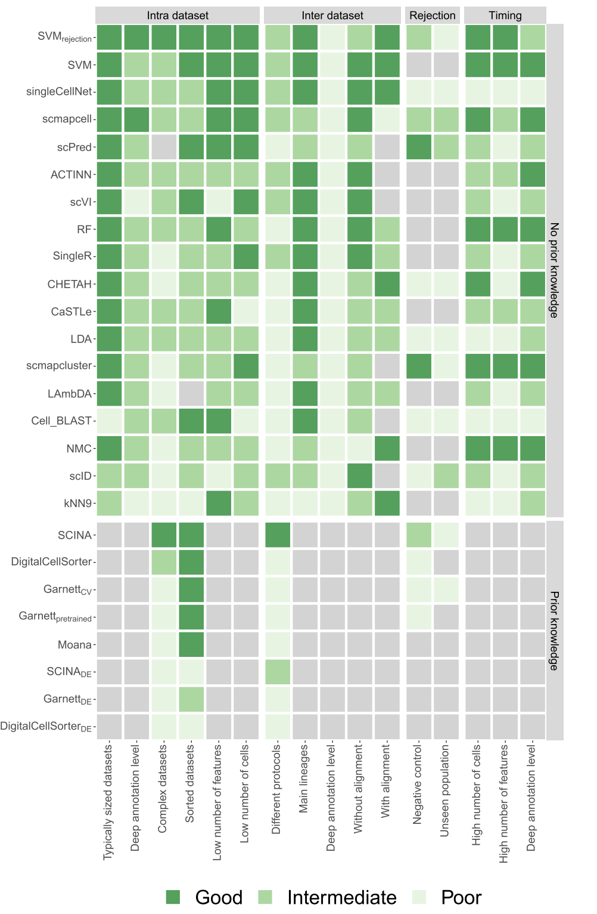

Slide 27
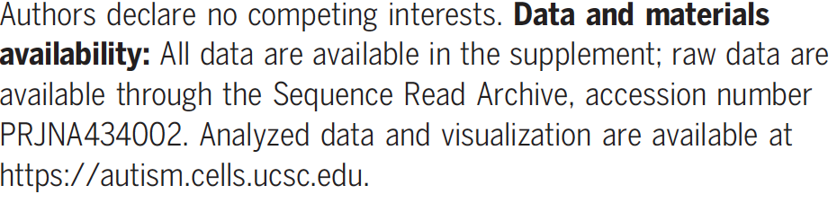
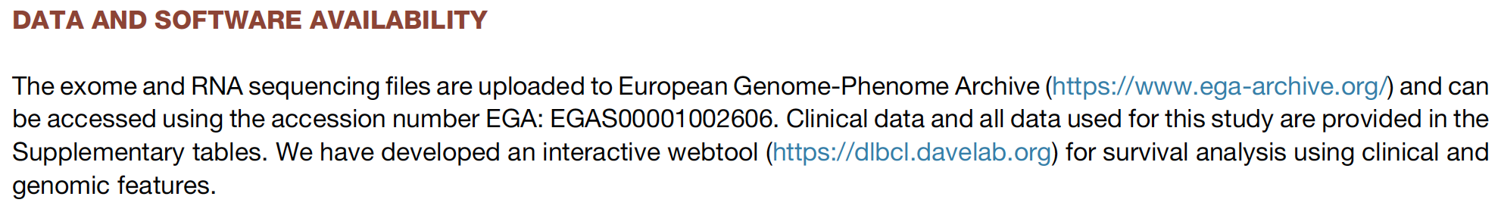
Obtain existing single cell datasets
Information from the original papers:

Slide 28
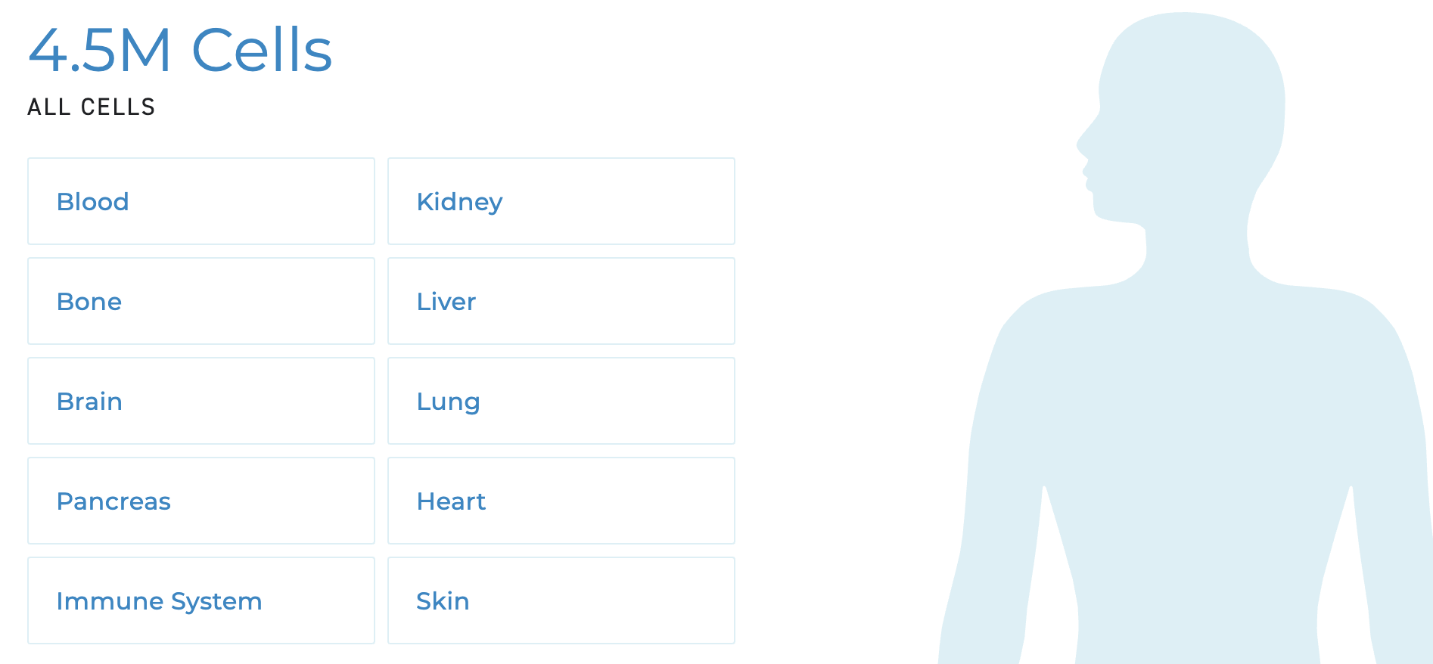
Obtain existing single cell datasets
Human cell atlas (https://data.humancellatlas.org/):

Slide 29
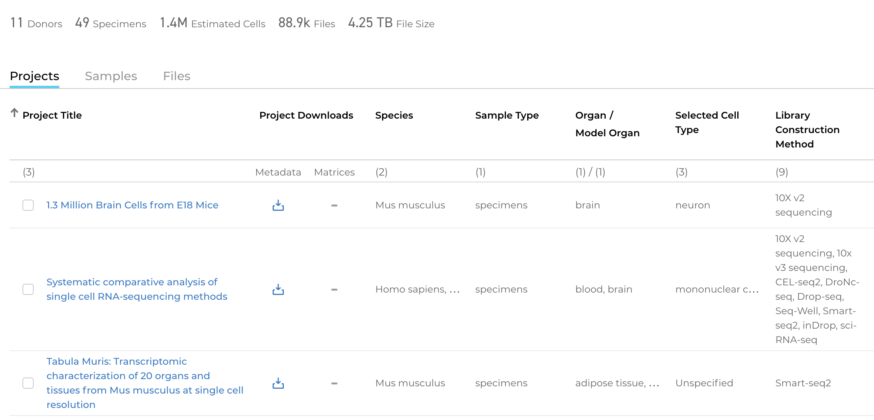
Obtain existing single cell datasets
Human cell atlas (https://data.humancellatlas.org/):

Slide 30
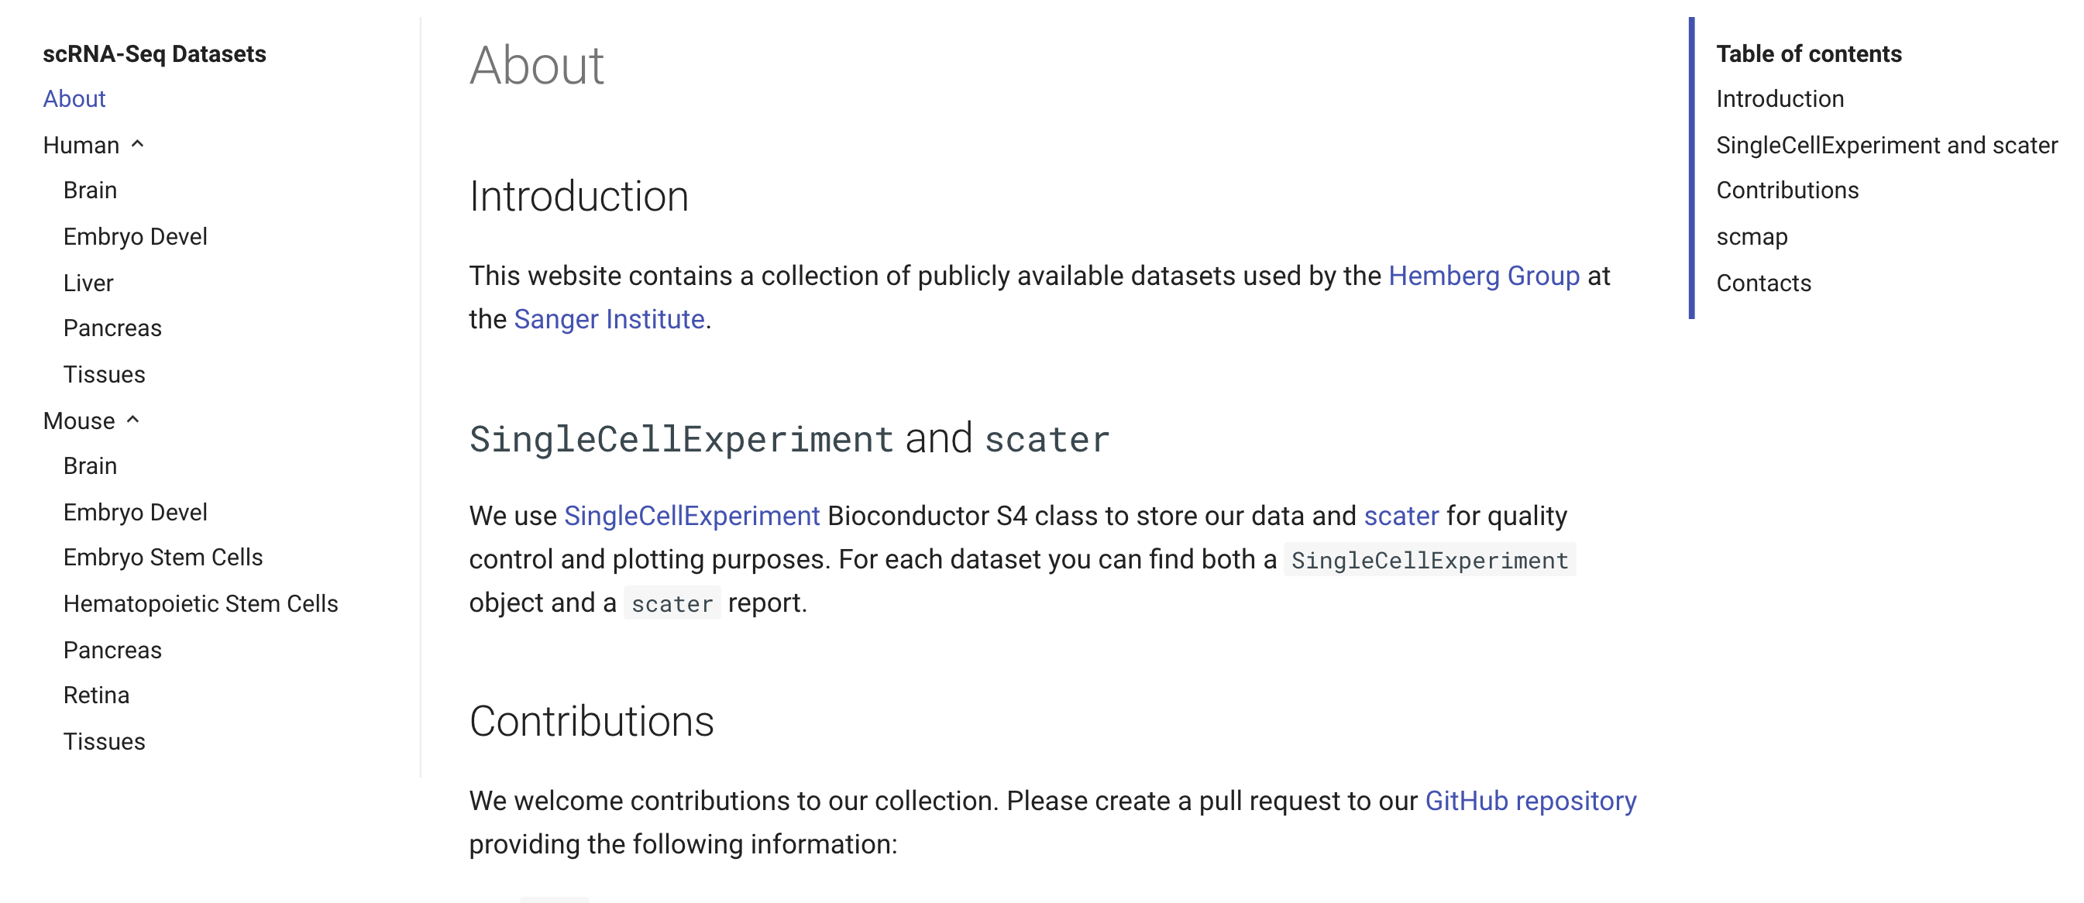
Obtain existing single cell datasets
Website (e.g. https://hemberg-lab.github.io/scRNA.seq.datasets/)

Slide 31
Data integration
Integrate data from different platforms, conditions, species, etc.
Similar to batch effect correction, but could be more broad
Seurat V3: CCA (Cell, 2019)
LIGER: Non-negative matrix factorization (Cell, 2019)
Harmony: Shared embedding learning using a modified soft k-means (Nat Methods, 2019)
scAlign: Shared embedding learning using revied autoencoder (Genome Biology, 2019)
scMC: variance correction based on technical and biological variation (Genome Biology 2021)

Slide 32
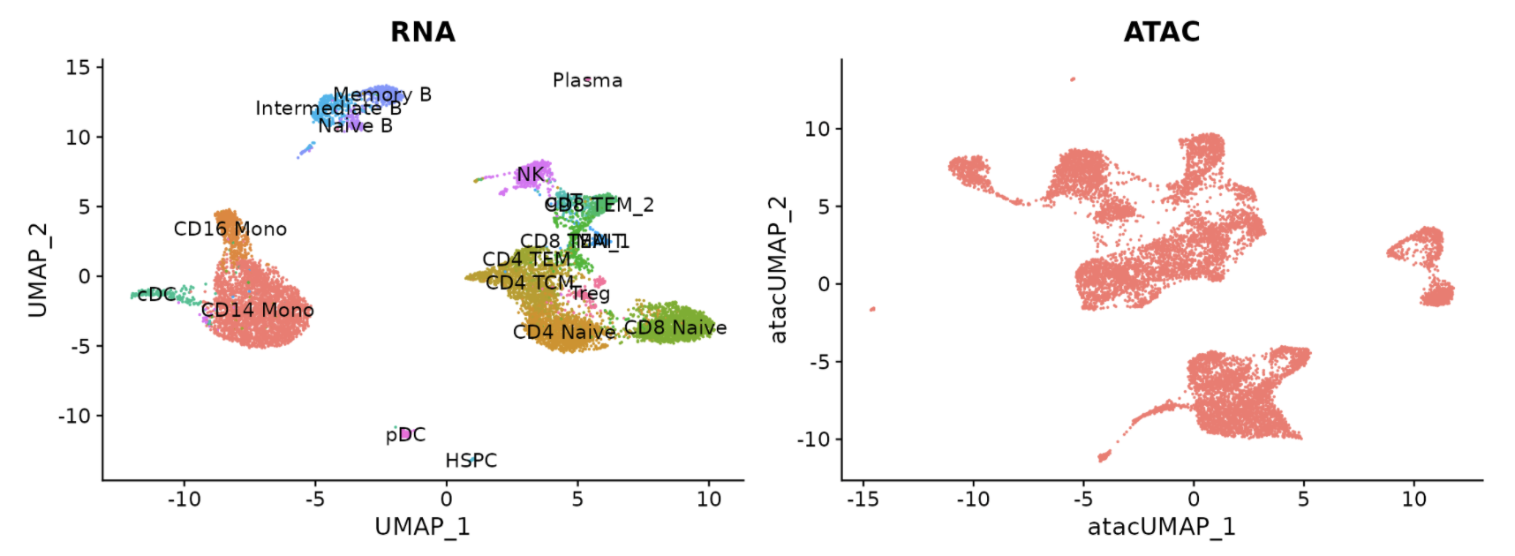
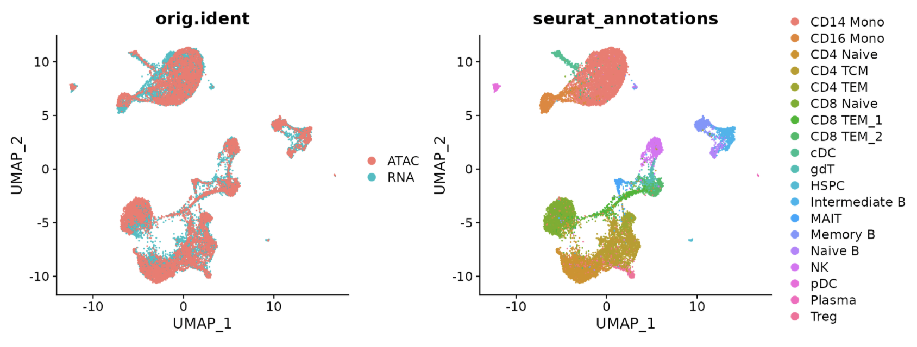
Before
After
https://satijalab.org/seurat/articles/atacseq_integration_vignette.html

Slide 33
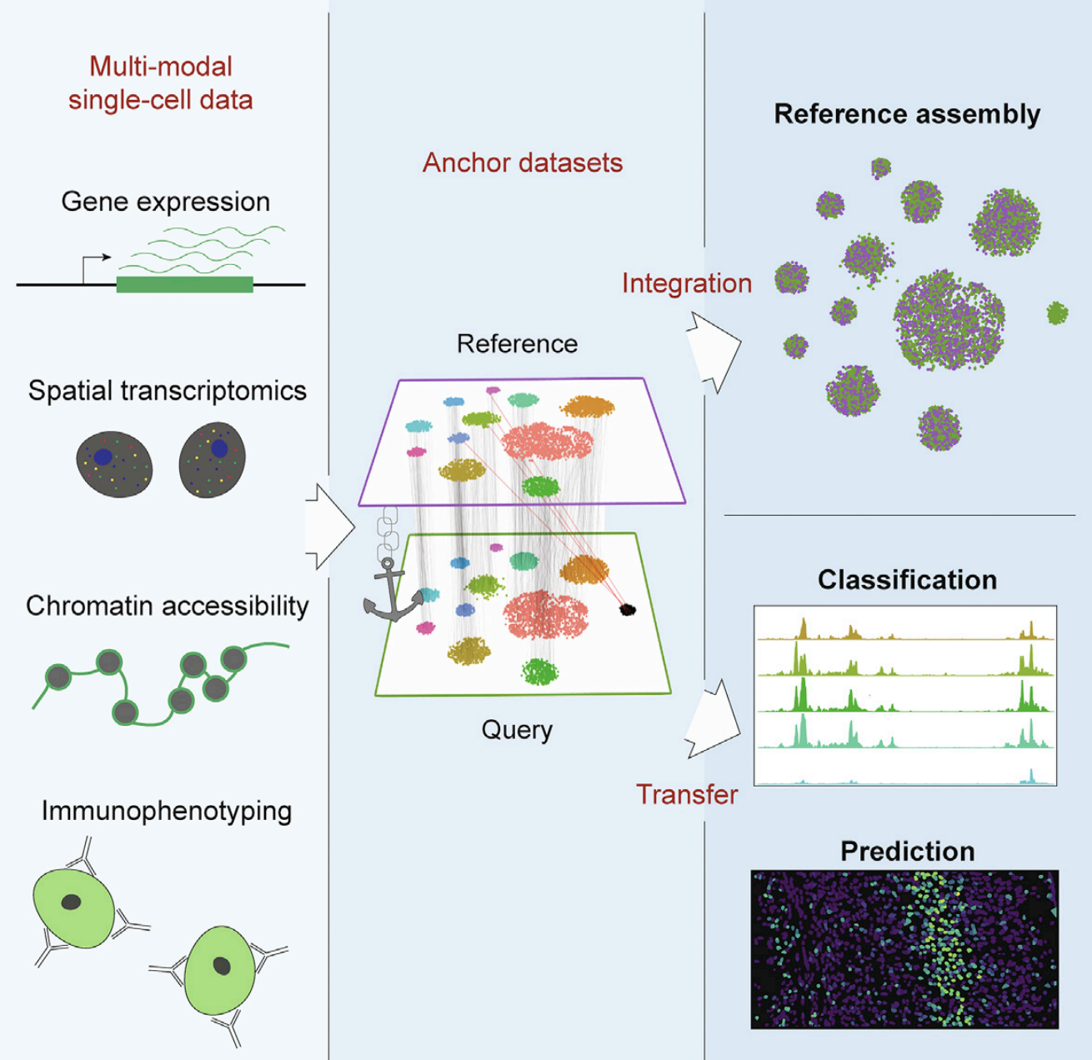
Seurat V3
Stuart et al. 2019, Cell

Slide 34
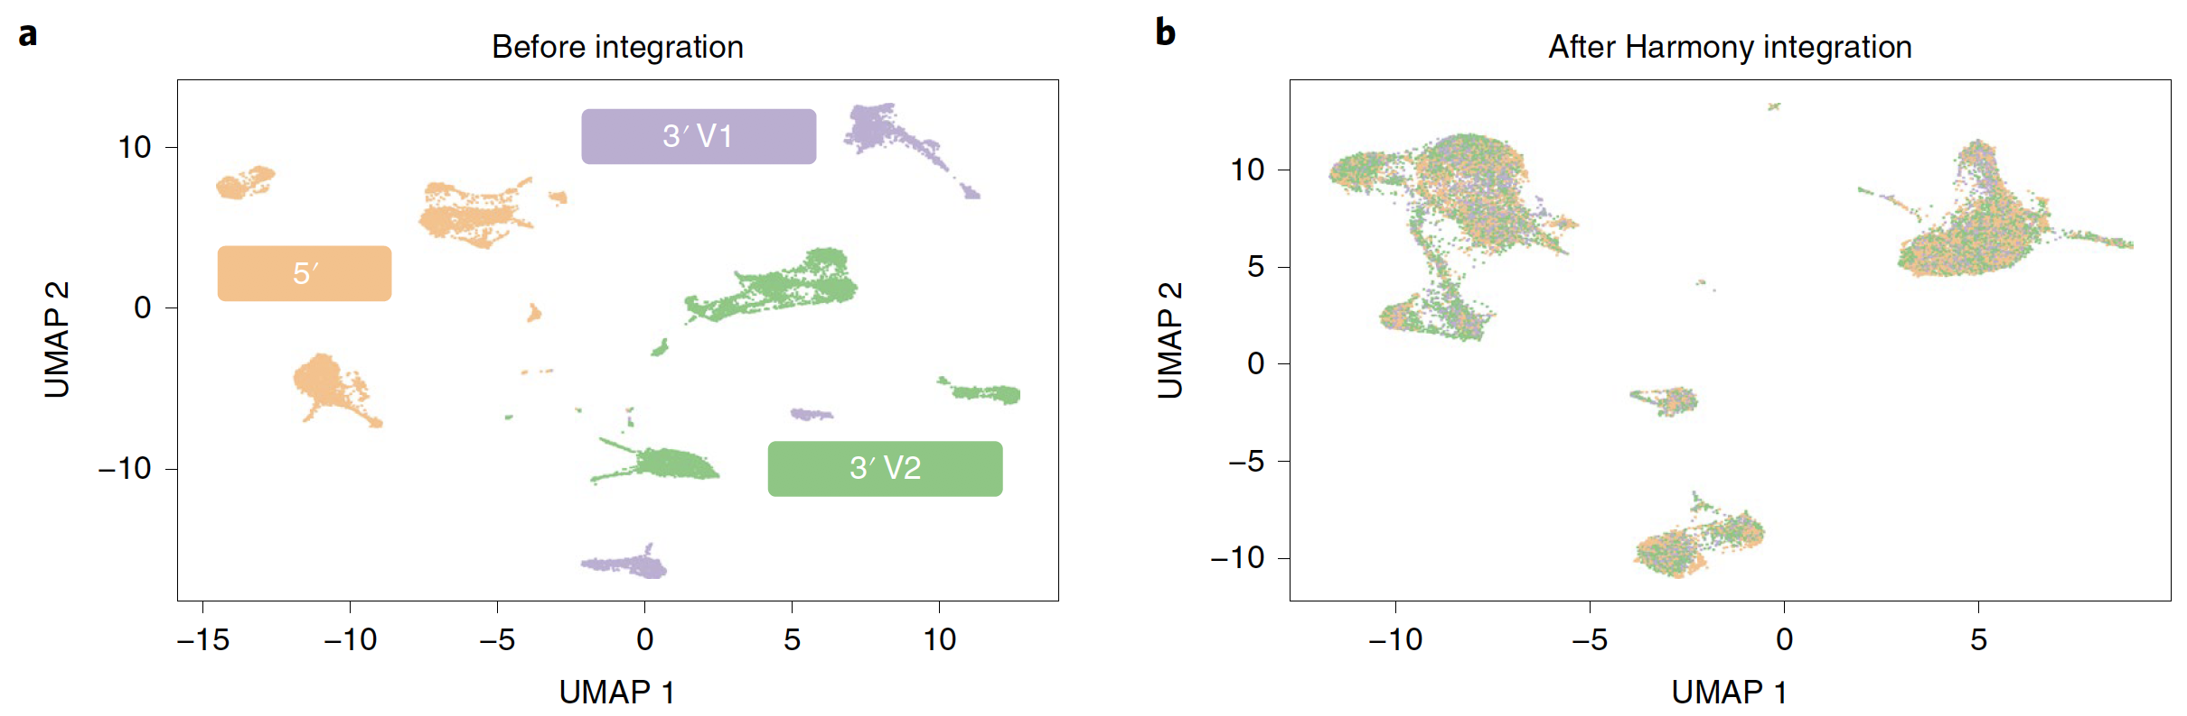
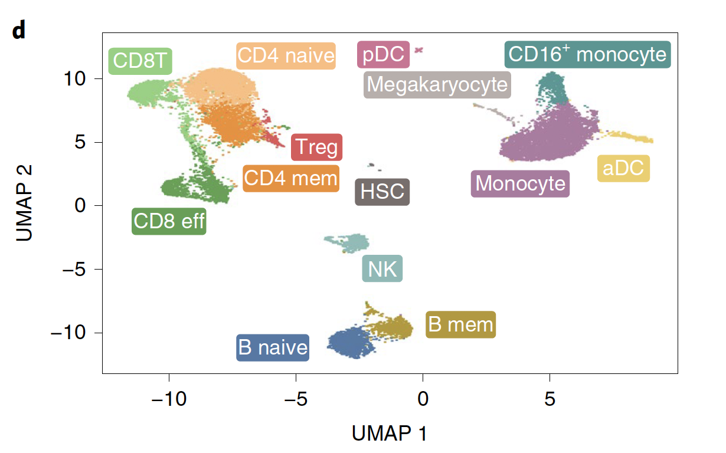
Korsunsky et al. 2019, Nat Methods

Slide 35
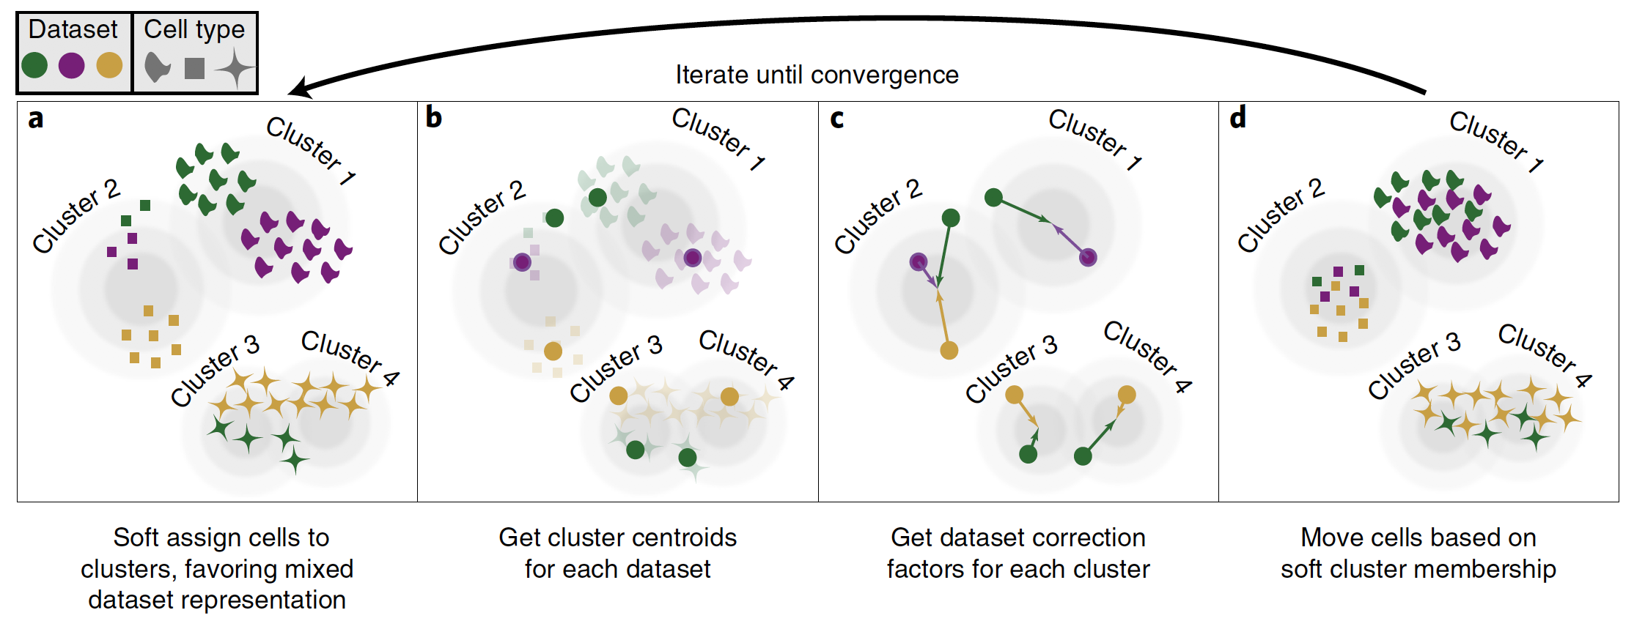
Harmony

